Slide 1
Sales Dashboard Insights for Business Stakeholders
Objective: Visualize sales performance by product, geography, and customer
Made by:- Sanya Nayyar

Slide 2
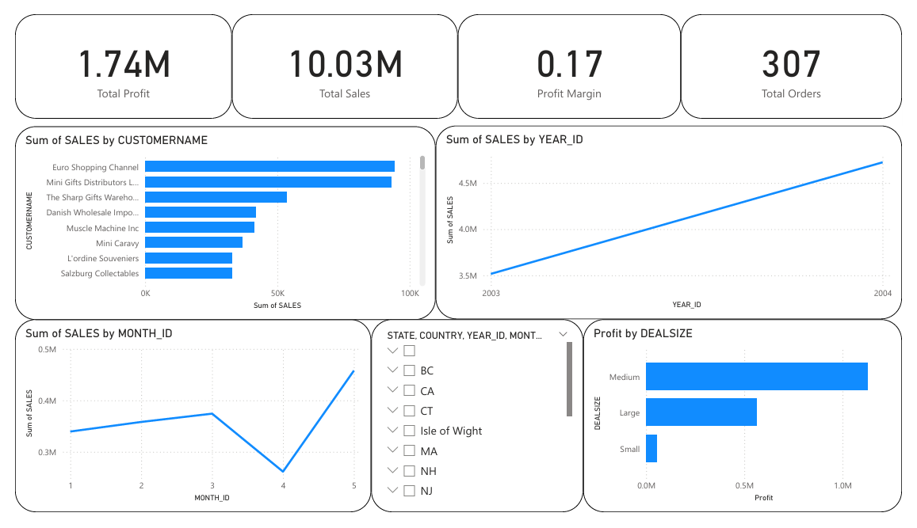
Sales Overview
At 4,57,861.06, 5 had the highest Sum of SALES and was 75.00% higher than 4, which had the lowest Sum of SALES at 2,61,633.29.﻿﻿﻿5 accounted for 25.56% of Sum of SALES.﻿﻿ ﻿﻿ ﻿﻿Across all 5 MONTH_ID, Sum of SALES ranged from 2,61,633.29 to 4,57,861.06.﻿﻿ ﻿﻿ ﻿

Slide 3
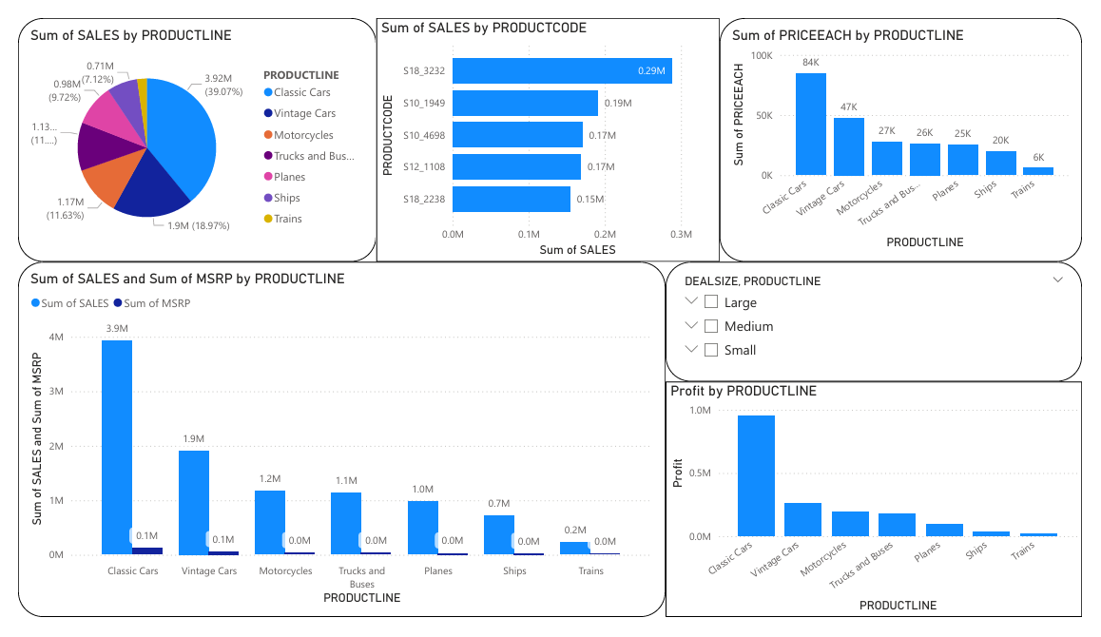
Product Performance
PRODUCTLINE was Classic Cars, when Sum of SALES were 38,03,686.66 higher than Sum of MSRP.﻿ Across all 5 PRODUCTCODE, Sum of SALES ranged from 1,54,623.95 to 2,88,245.42.﻿

Slide 4
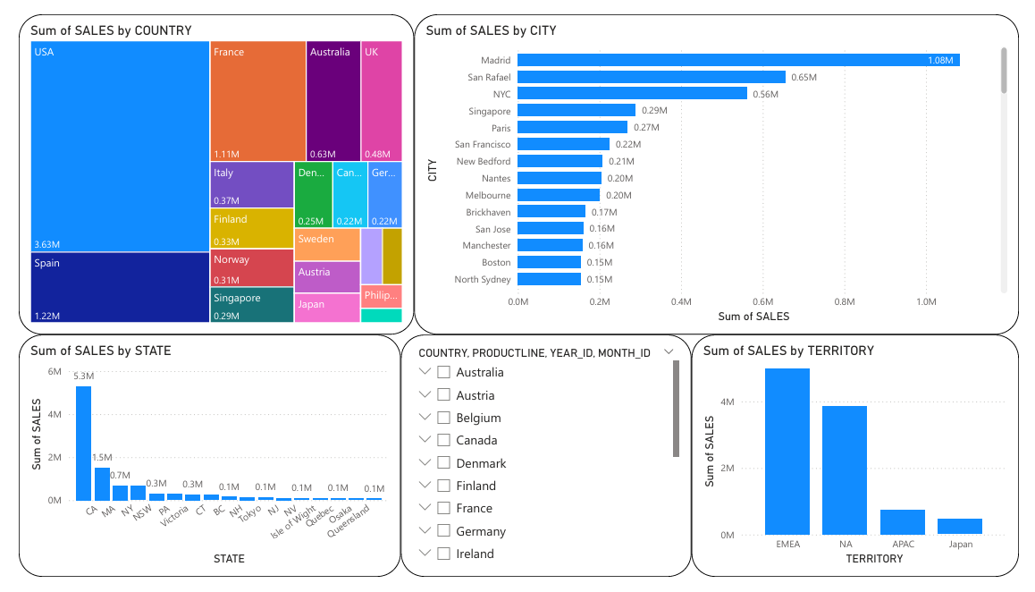
Geographic Insights
﻿At 10,82,551.44, Madrid had the highest Sum of SALES and was 3,137.29% higher than Charleroi, which had the lowest Sum of SALES at 33,440.10.﻿ Madrid accounted for 10.79% of Sum of SALES.﻿ Across all 73 CITY, Sum of SALES ranged from 33,440.10 to 10,82,551.44.﻿

Slide 5
How It Supports Business Decision-Making
This interactive Power BI dashboard empowers business stakeholders with data-driven insights to make strategic decisions. It includes:
KPI Cards for quick glance at Total Sales, Orders, and Profit
Sales Trend Analysis over months and years to identify growth or decline
Top Products and Customers to focus on high-value segments
Geographic Breakdown of sales by country, state, and city to guide regional strategies
Product Line Performance visuals to decide where to invest or reduce focus
Interactive Filters (slicers) for year, product line, country, and deal size, enabling dynamic exploration
Outcome: This dashboard helps stakeholders identify high-performing areas, spot declining trends, optimize product strategy, and allocate resources effectively.

